Slide 1

Raluca Nicola – Web Cartographer at Esri
Digital Ideation, Hochschule Luzern – September 20, 2023

Slide 2
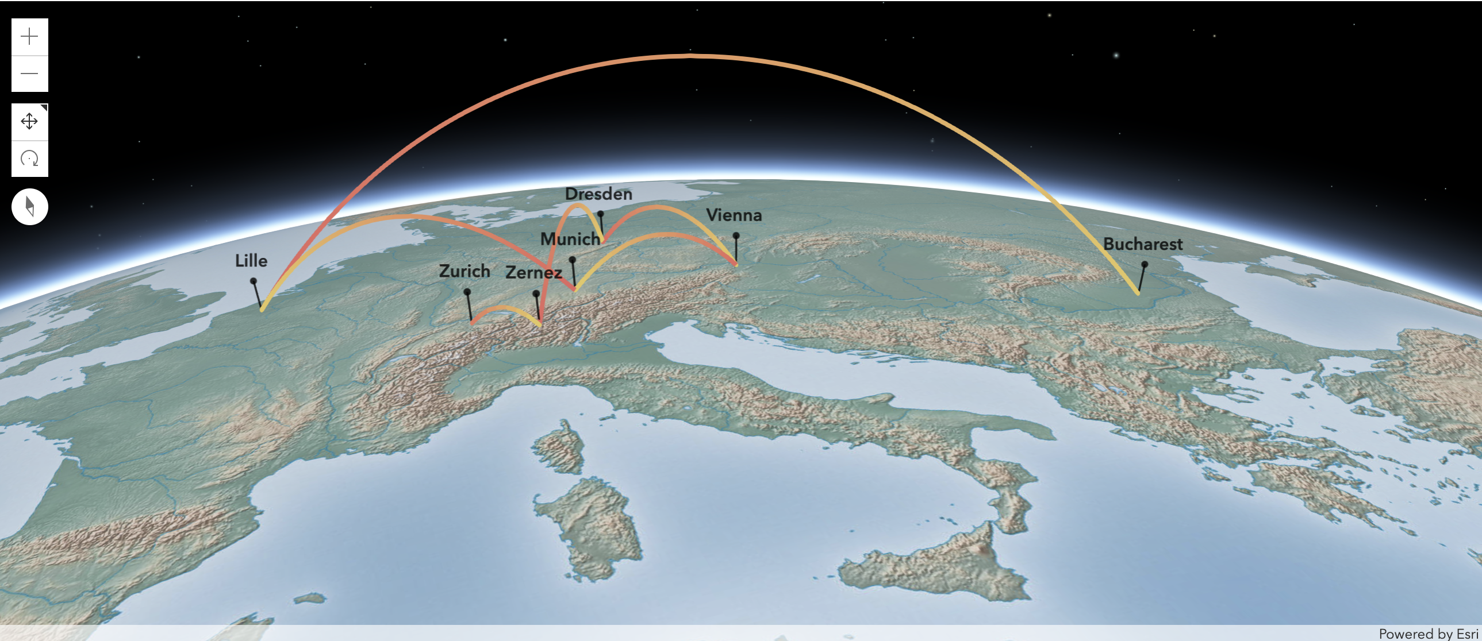
About me
Bachelor in Geography, University of Bucharest
Erasmus exchange, Lille Technical University
International Master of Cartography,
Technical Universities of Munich, Vienna and Dresden
GIS Internship, Swiss National Park
Teaching Assistant, Cartography Institute ETH Zurich
Cartographer, Esri R&D Center Zurich

Slide 3
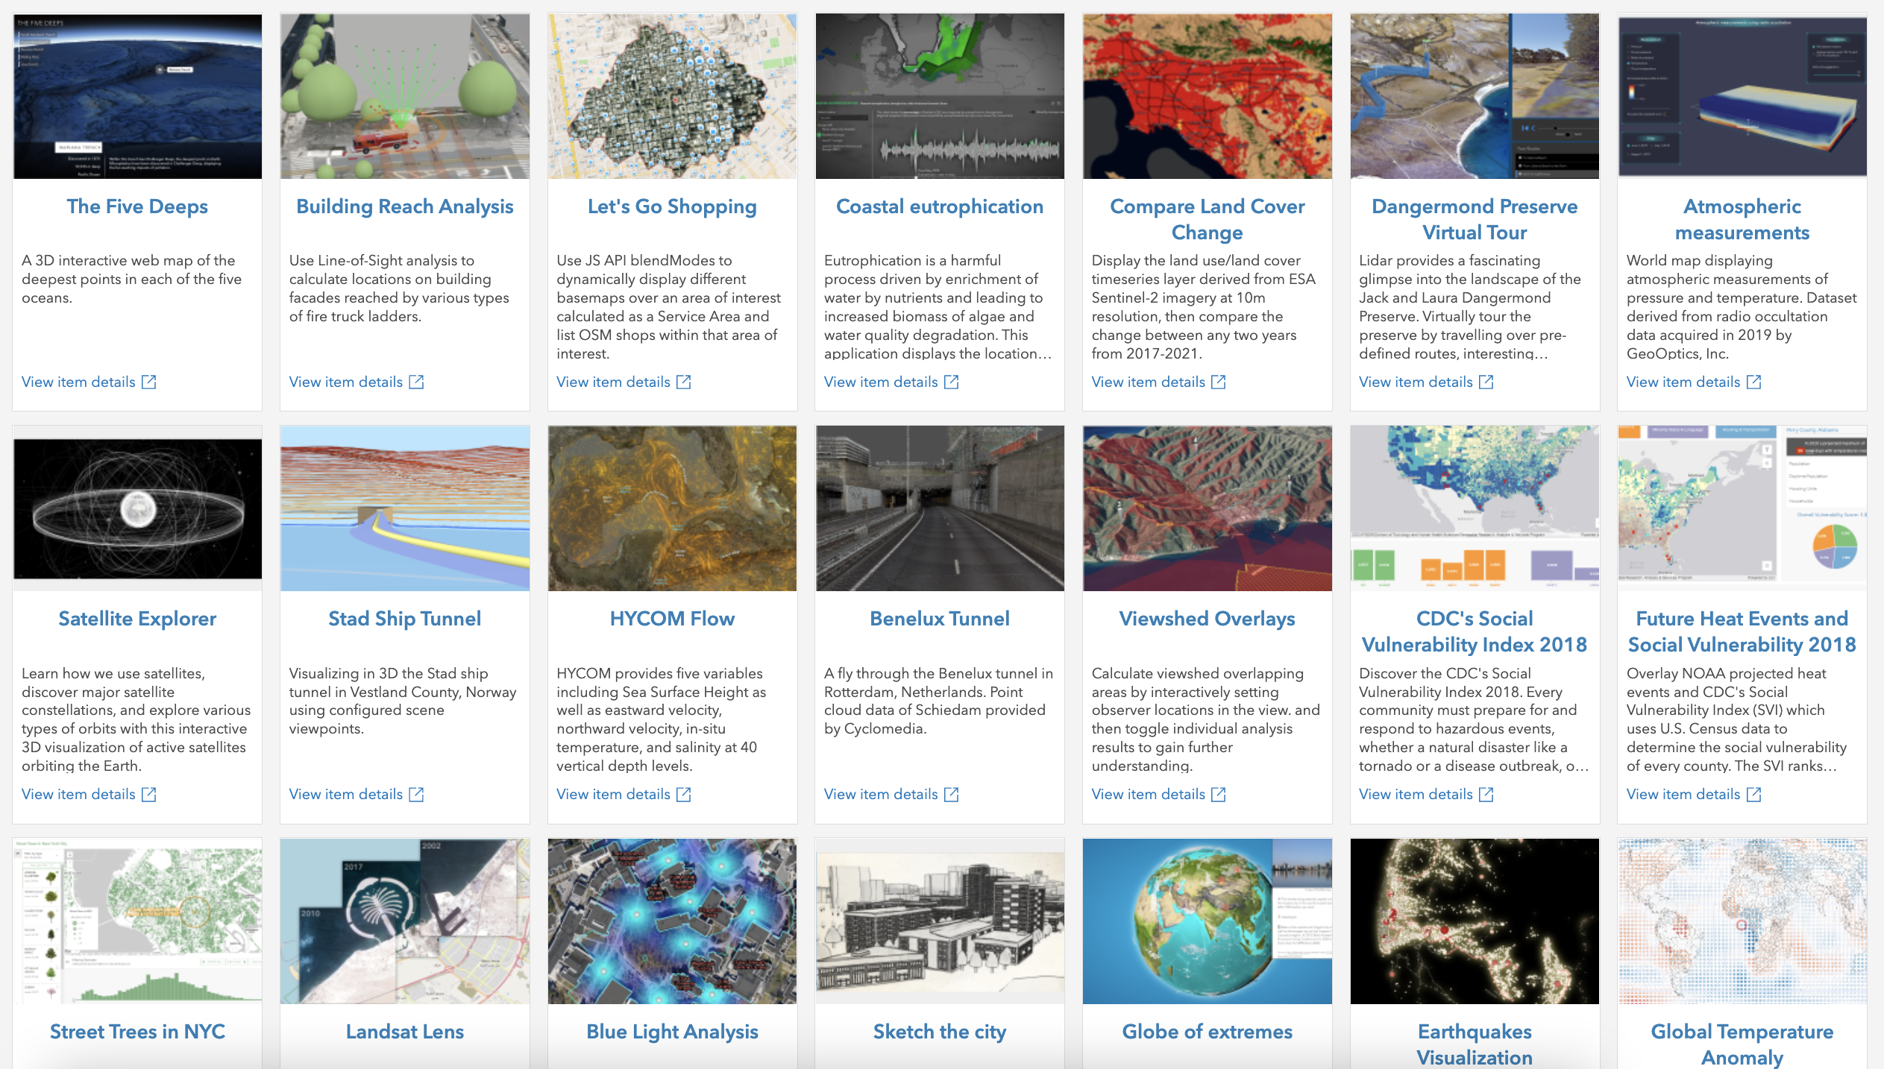

My daily work
Build custom web mapping prototypes and demos as part of the Application Prototype Lab team

Slide 4
Agenda
Workflow when creating maps
Idea > Data > Design > Implement > Test > Share
Examples

Slide 5
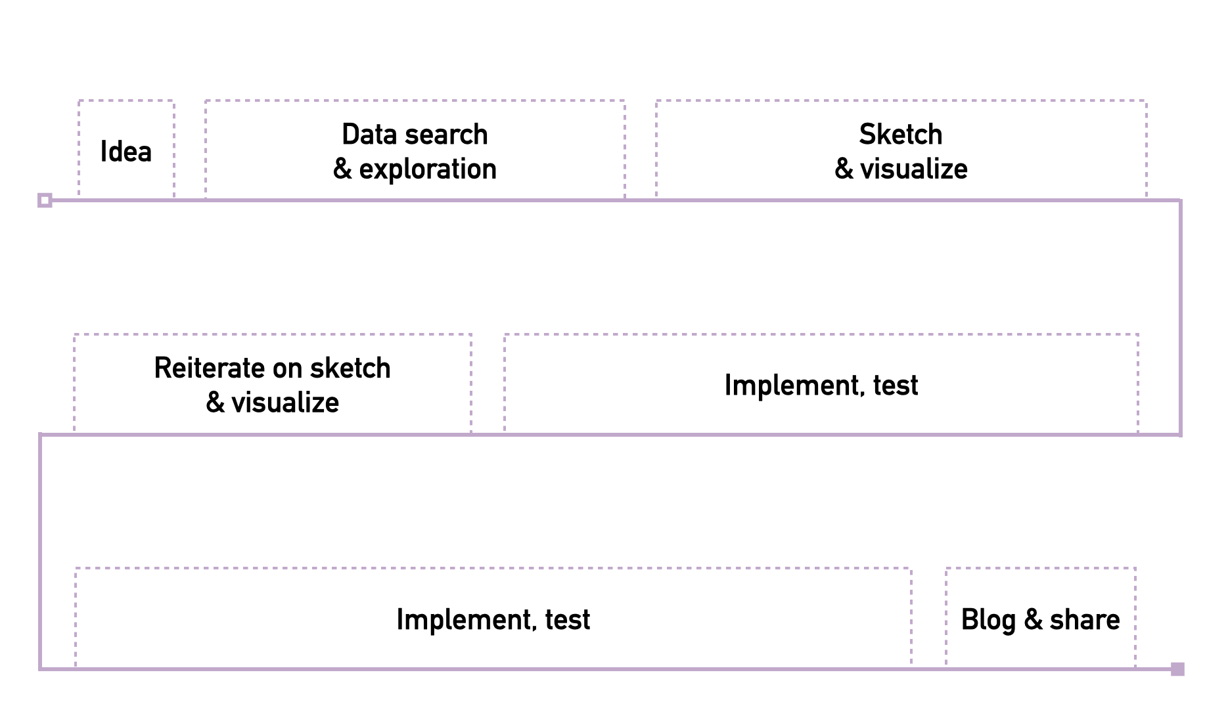
Workflow

Slide 6
Idea
Curiosities
Example: where is the highest internet speed connection in the world? How did my city expand in the last 50 years?
Inspiration
Example: a map you saw in a book or in a game
Personal
Example: track my route to work/university, map my holiday

Slide 7
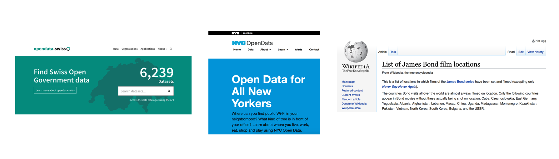
Data search and exploration
Get data from open data portals/parse it from websites
Explore data in ArcGIS Pro, QGIS, Excel, R, ArcGIS Online, Mapbox Studio

Slide 8
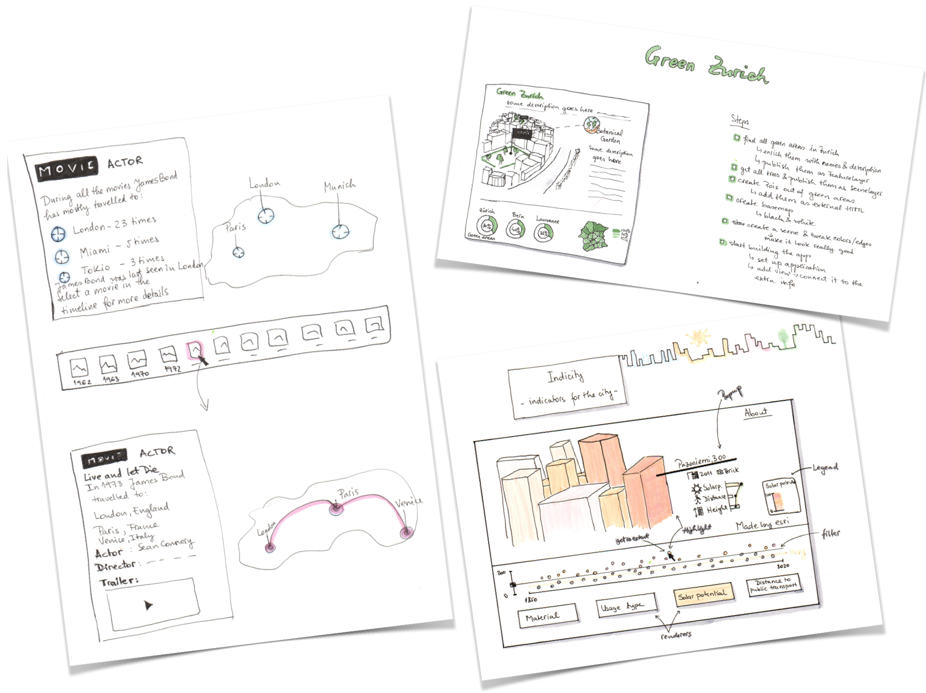
Sketch your ideas

Slide 9
Mapping libraries
Leaflet
ArcGIS API for JavaScript
Mapbox GL JS
CesiumJS
deck.gl
D3
ThreeJS
OpenLayers
Google Maps Platform – Maps JavaScript API
HERE Maps API for JavaScript
General visualization purpose
Mapping specific

Slide 10
Develop, test and share
code, code, 🍫, code
test, test
code, some more 🍫, code, code
show app to my colleagues and get feedback
code, 🍭, code
some more feedback
some more code
deploy, write blog post and share with everyone 🎉 🎊

Slide 11
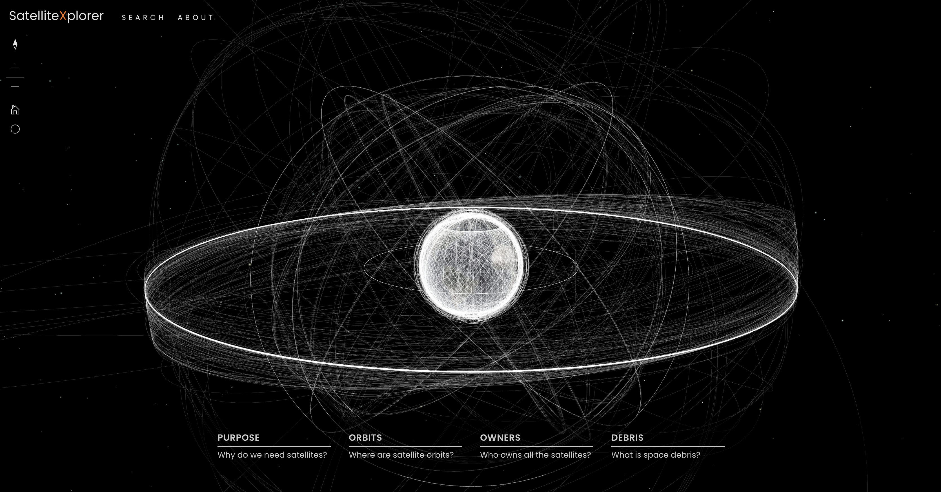
Space - satellite explorer
https://geoxc-apps.bd.esri.com/space/satellite-explorer/

Slide 12
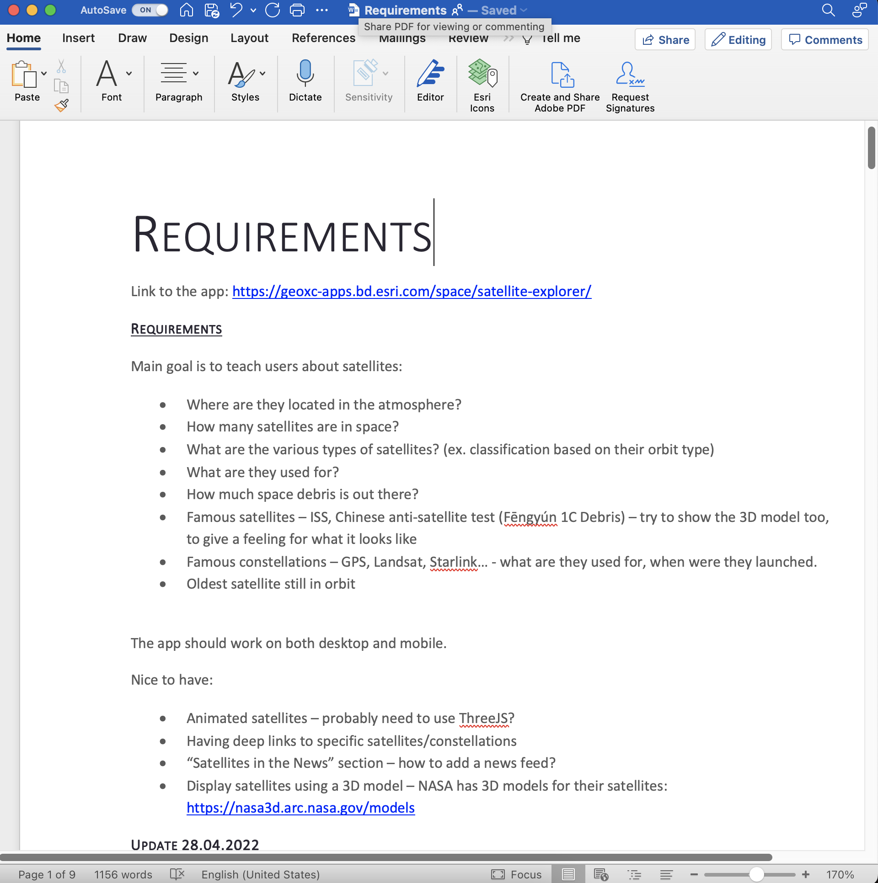
Satellite Explorer - idea

Slide 13
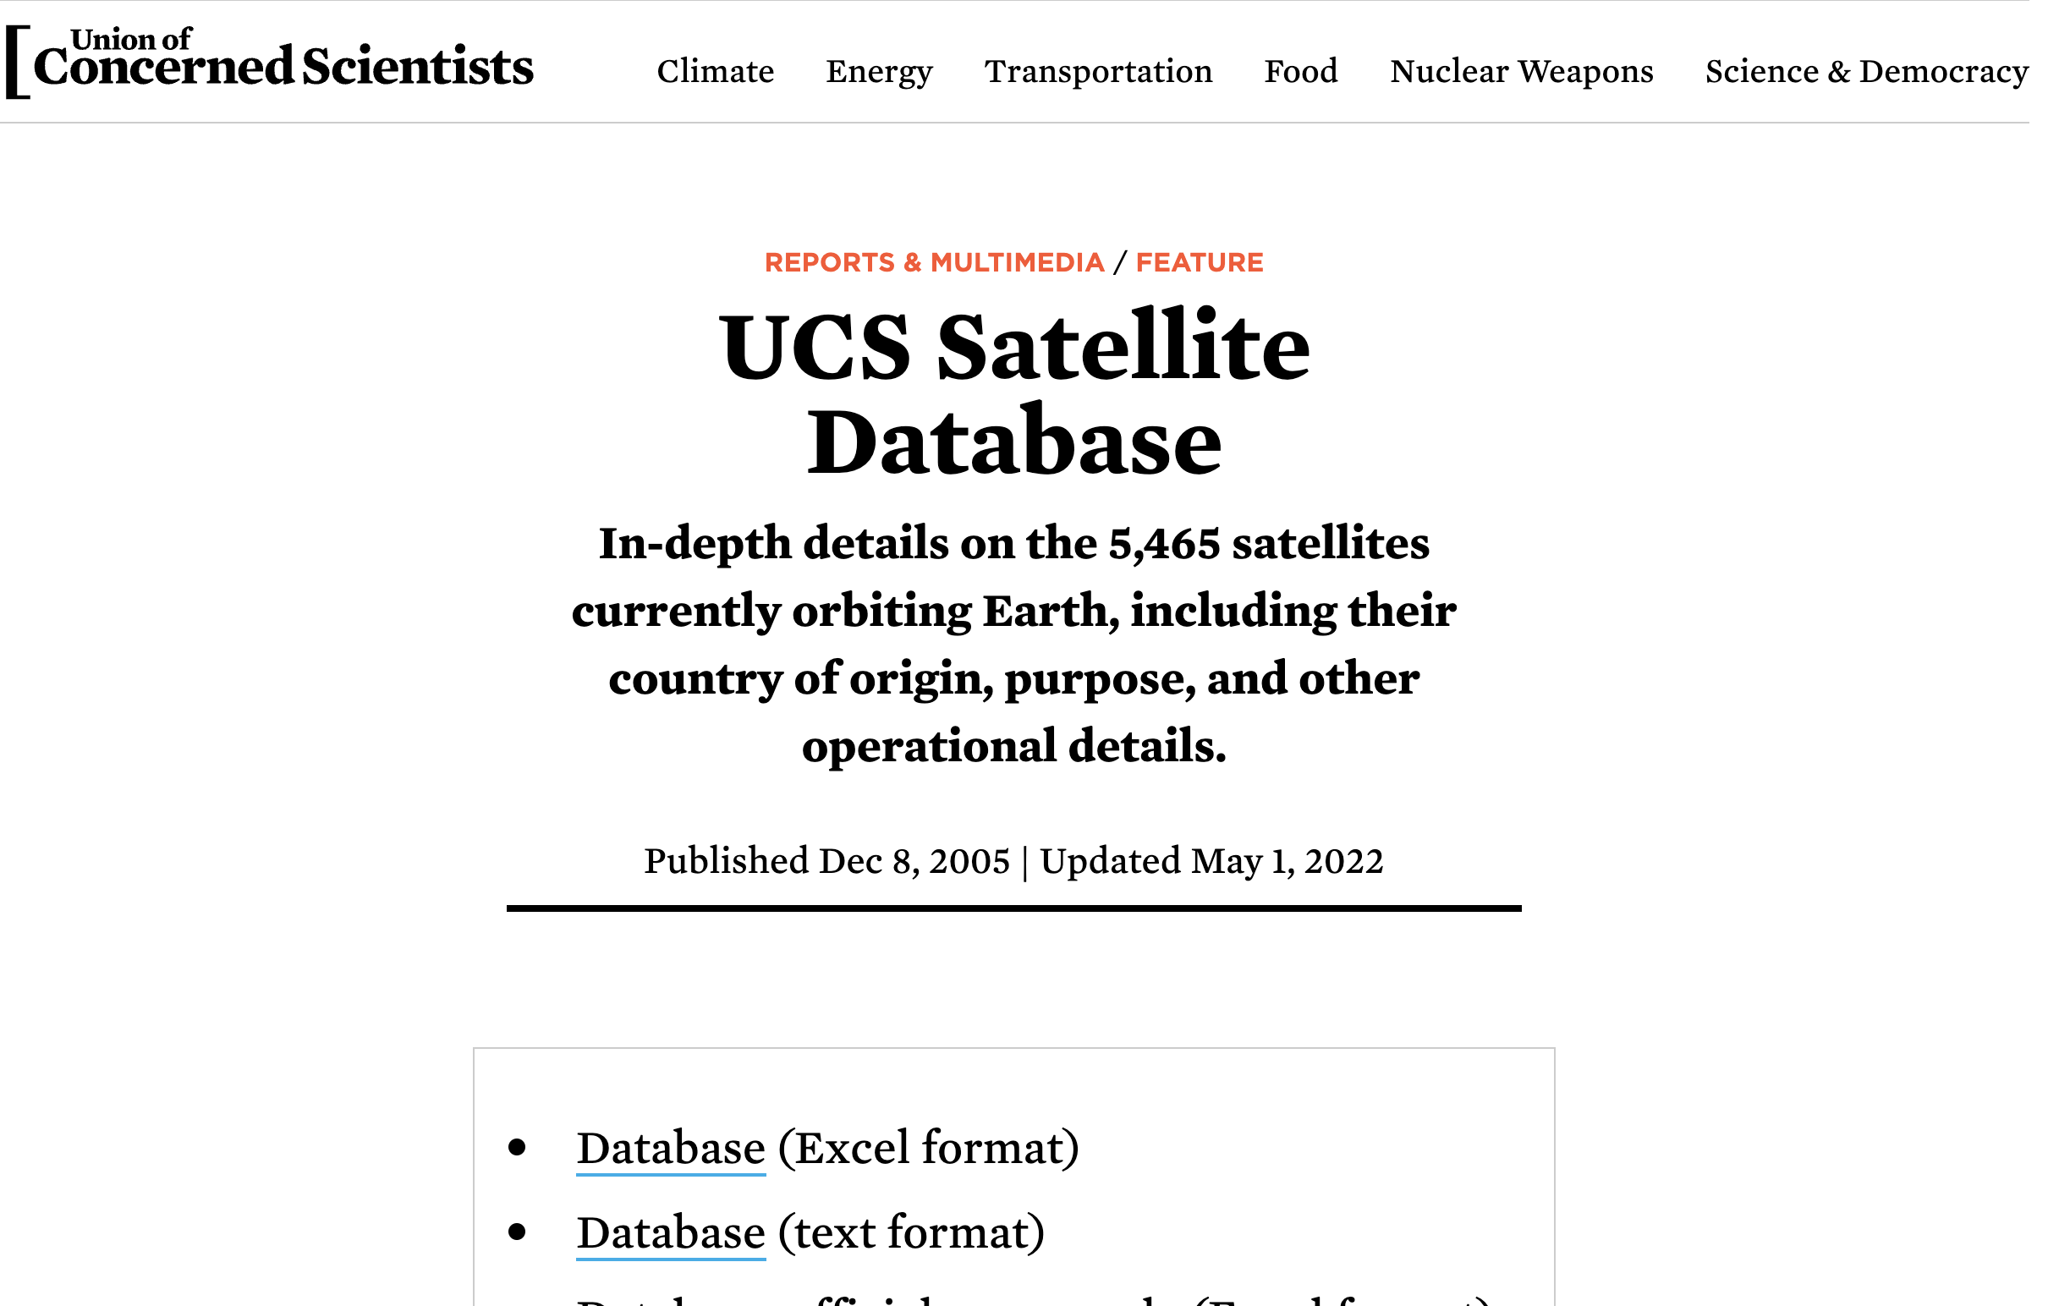
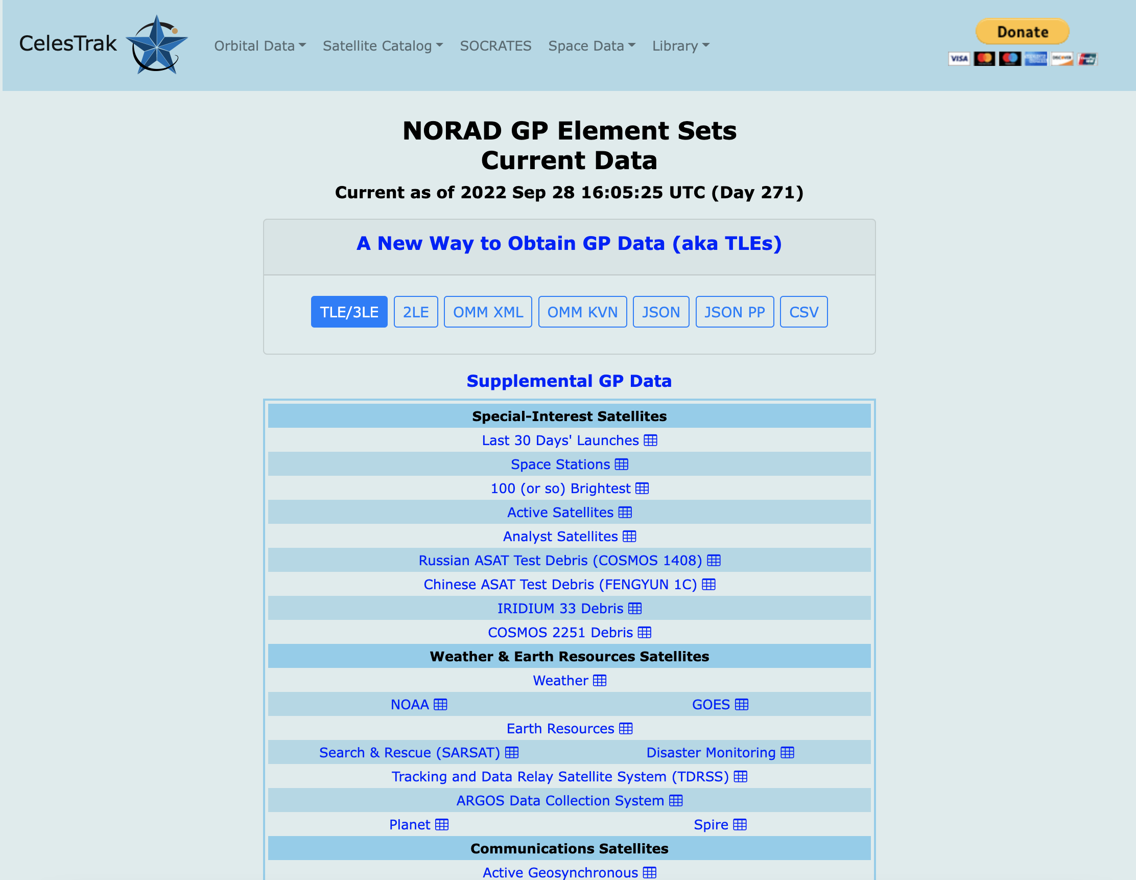
Satellite Explorer – data

Slide 14
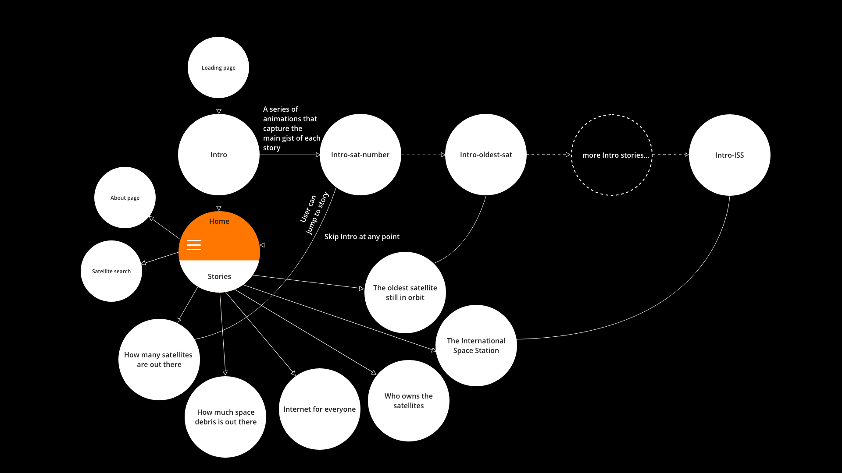
Satellite Explorer - sketch

Slide 15
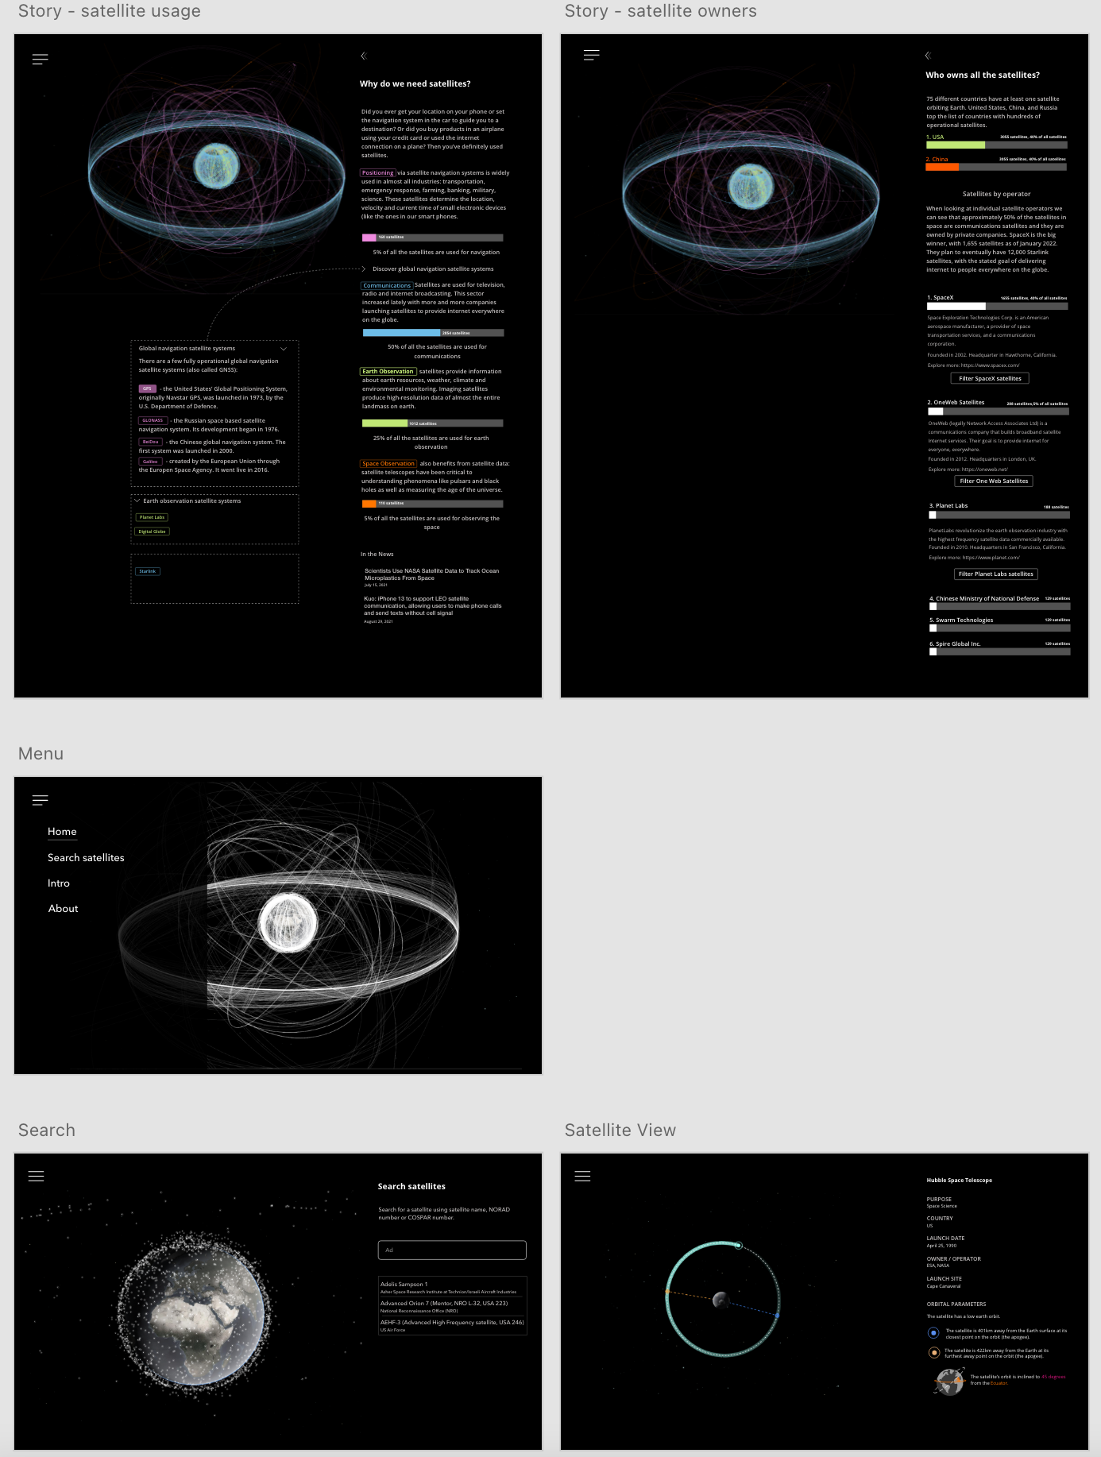
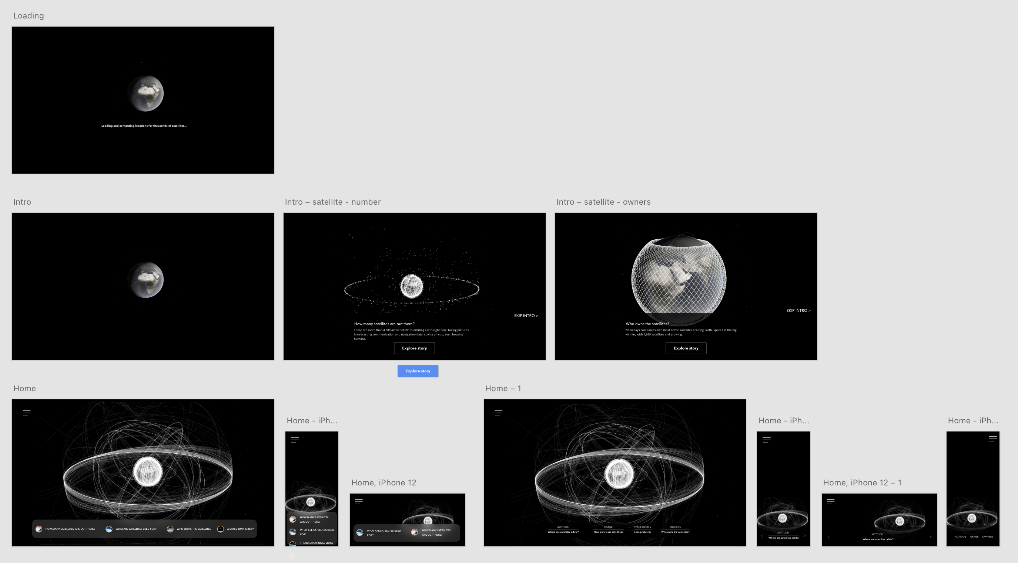
Satellite Explorer - sketch

Slide 16
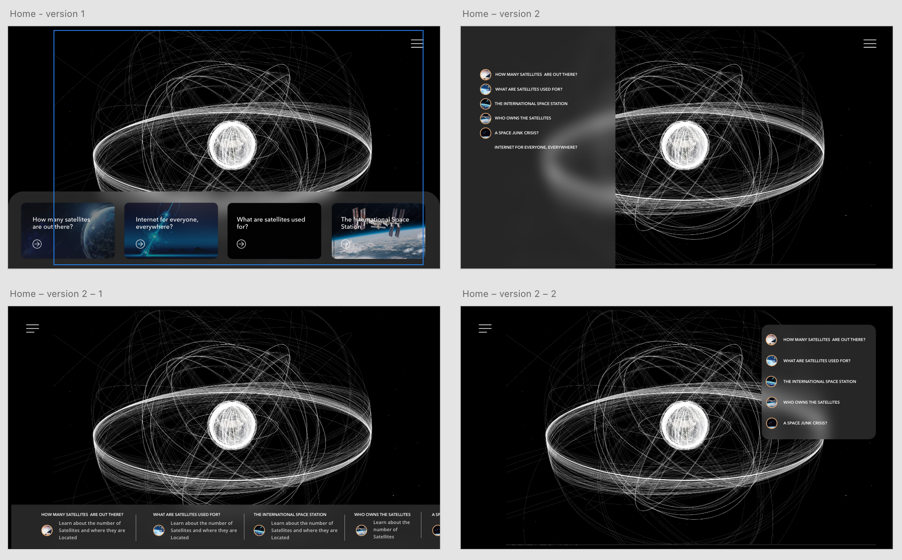
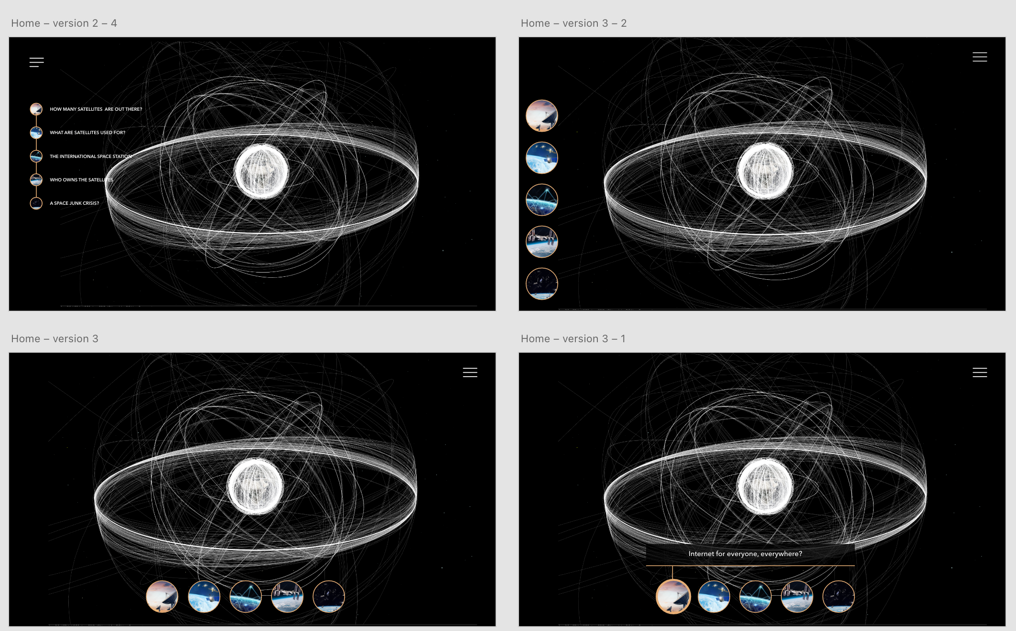
Satellite Explorer - sketch

Slide 17
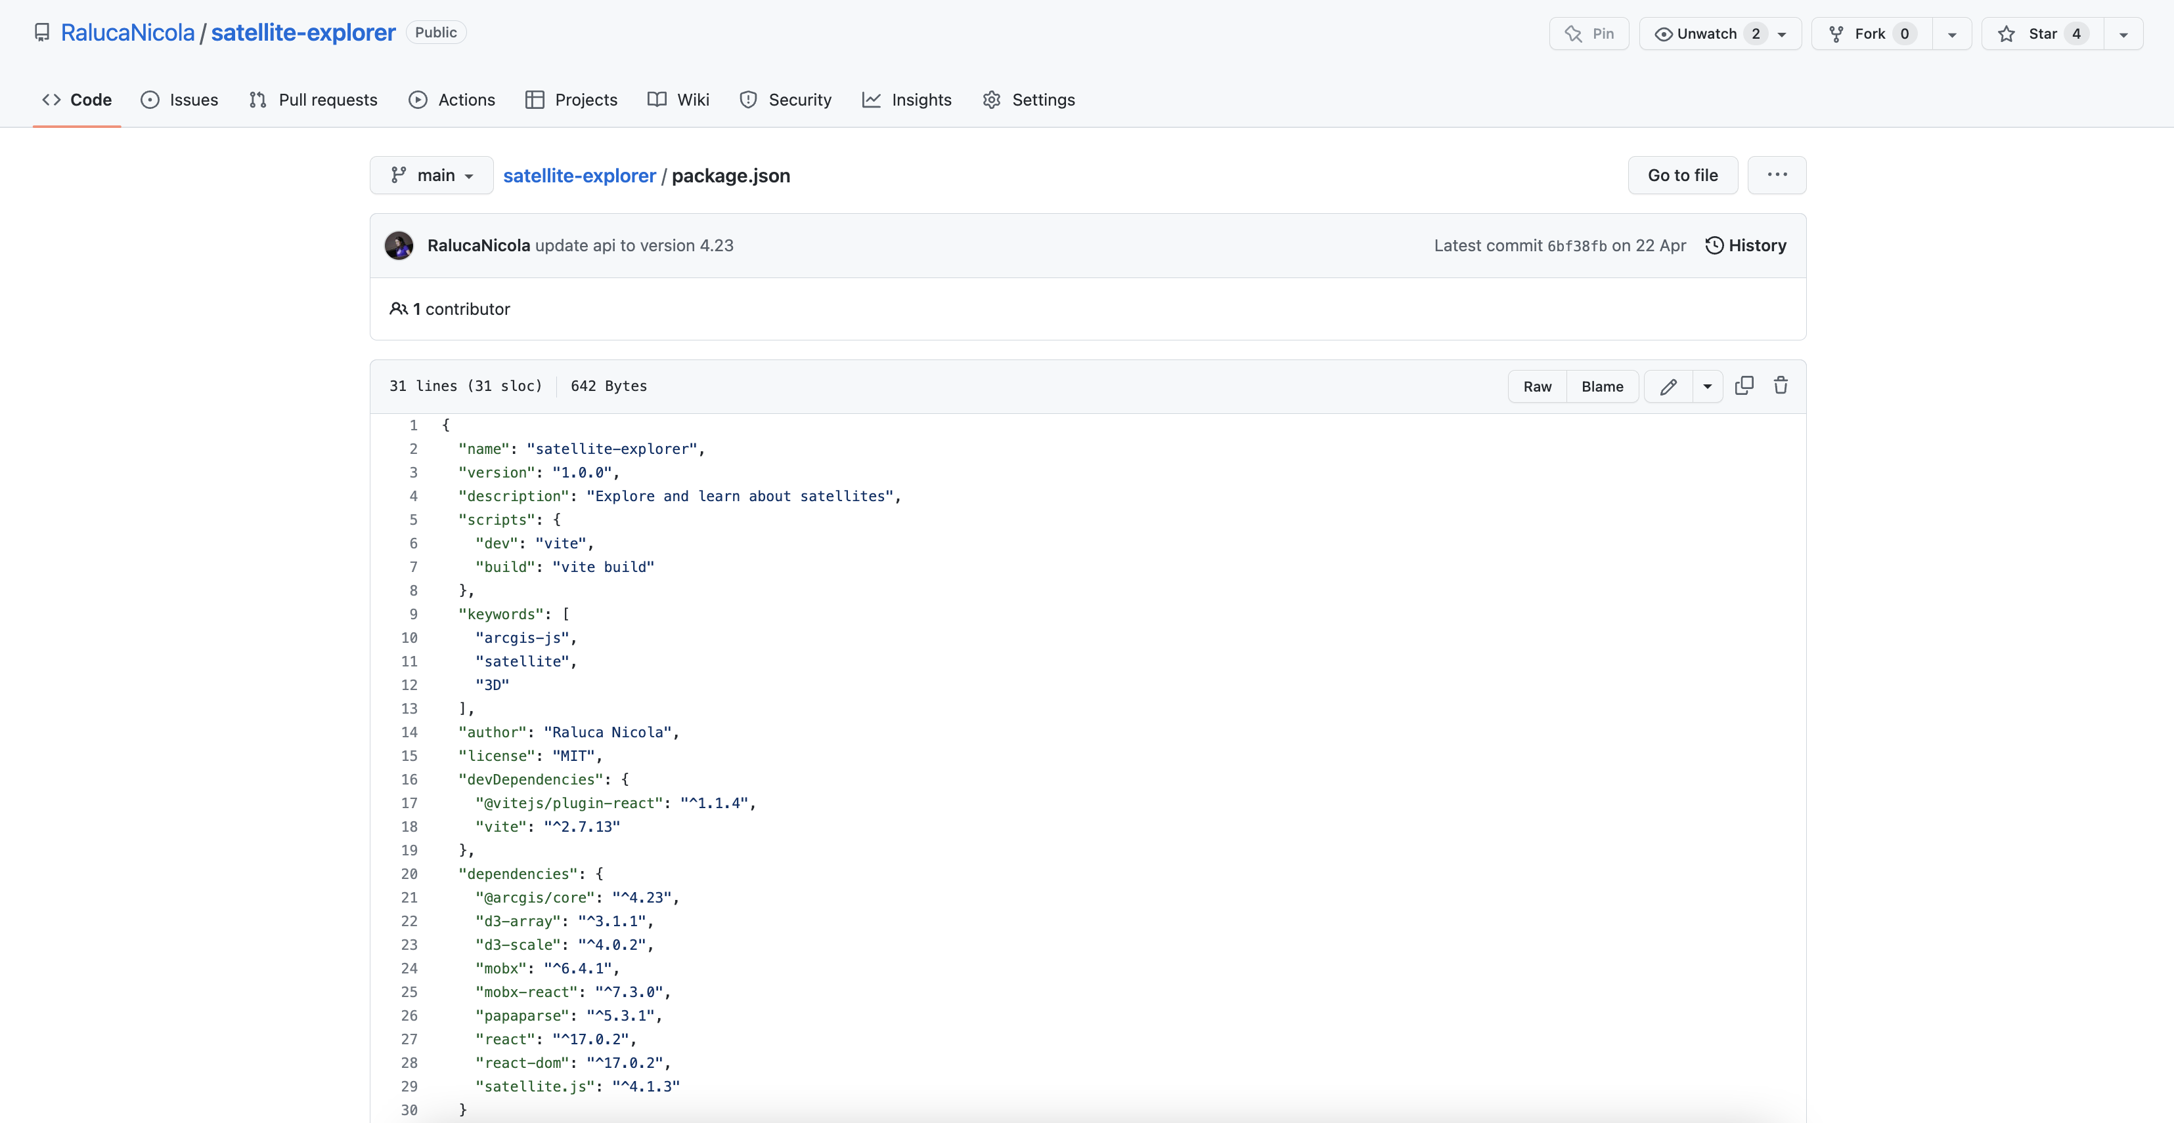
Satellite Explorer - code
https://github.com/RalucaNicola/satellite-explorer/

Slide 18
Satellite Explorer - demo
https://geoxc-apps.bd.esri.com/space/satellite-explorer/

Slide 19

A happiness map
https://ralucanicola.github.io/happy-moments/

Slide 20
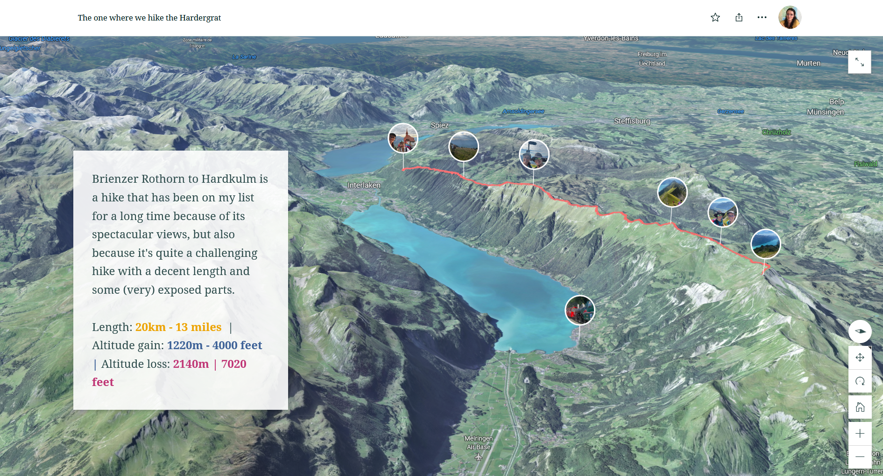
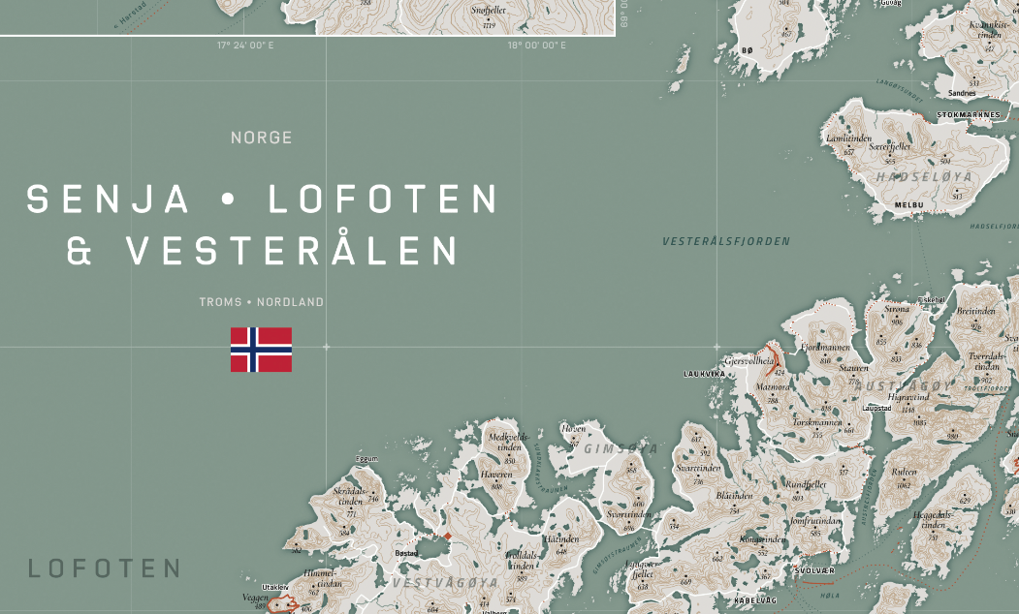
Personal maps - hiking
https://storymaps.arcgis.com/stories/46eafe55d96b43de97fbdd2dc6b6b433
https://www.visualcinnamon.com/portfolio/map-norway/

Slide 21
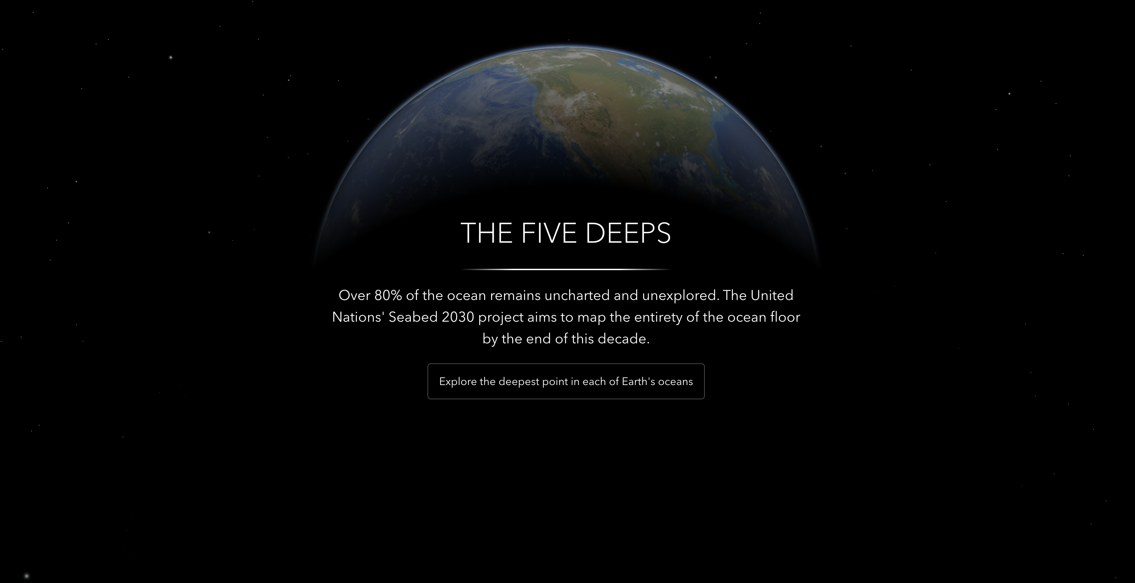
Discovery
https://geoxc-apps4.bd.esri.com/five-deeps/

Slide 22
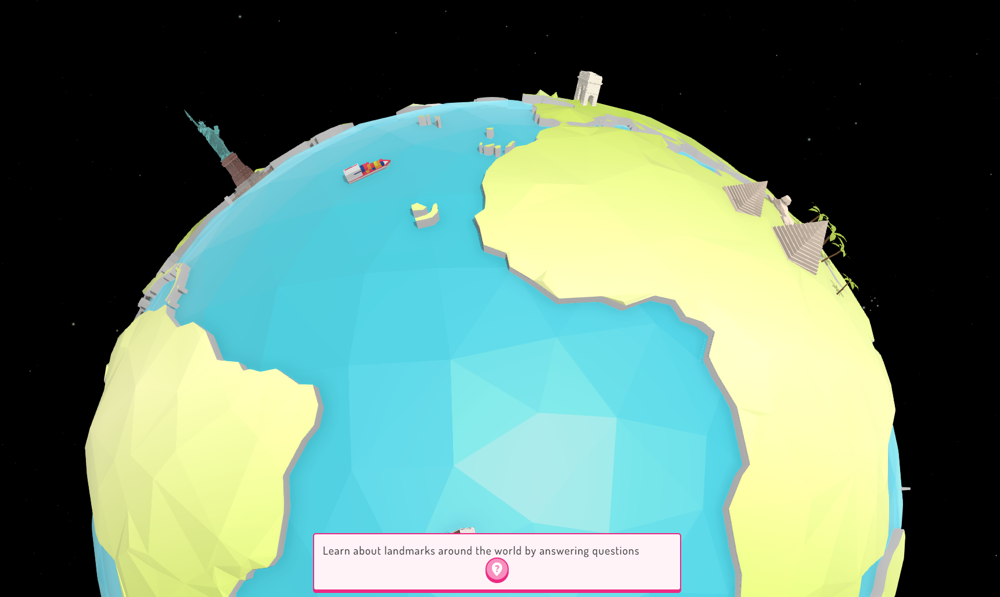
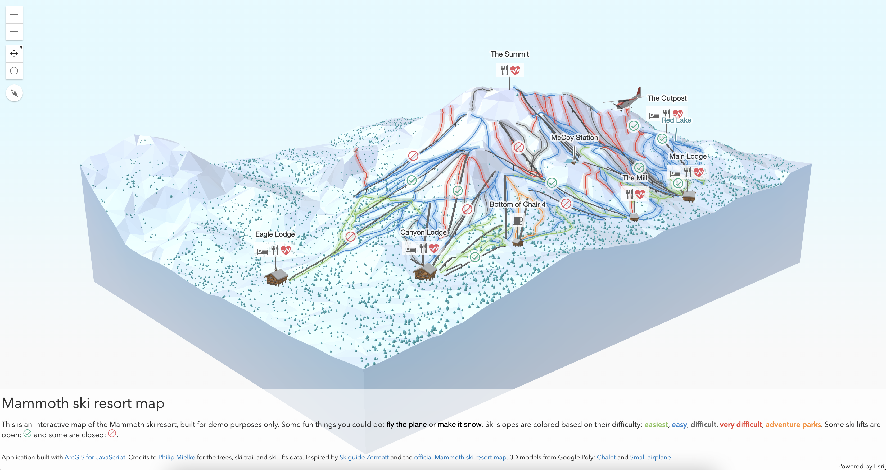
Games
Work In Progress…
https://ralucanicola.github.io/ski-resort-map/

Slide 23
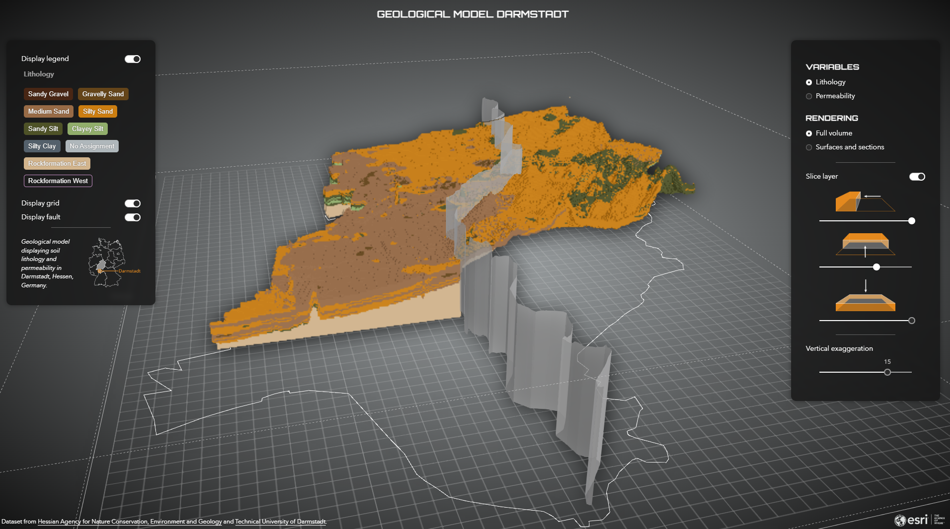
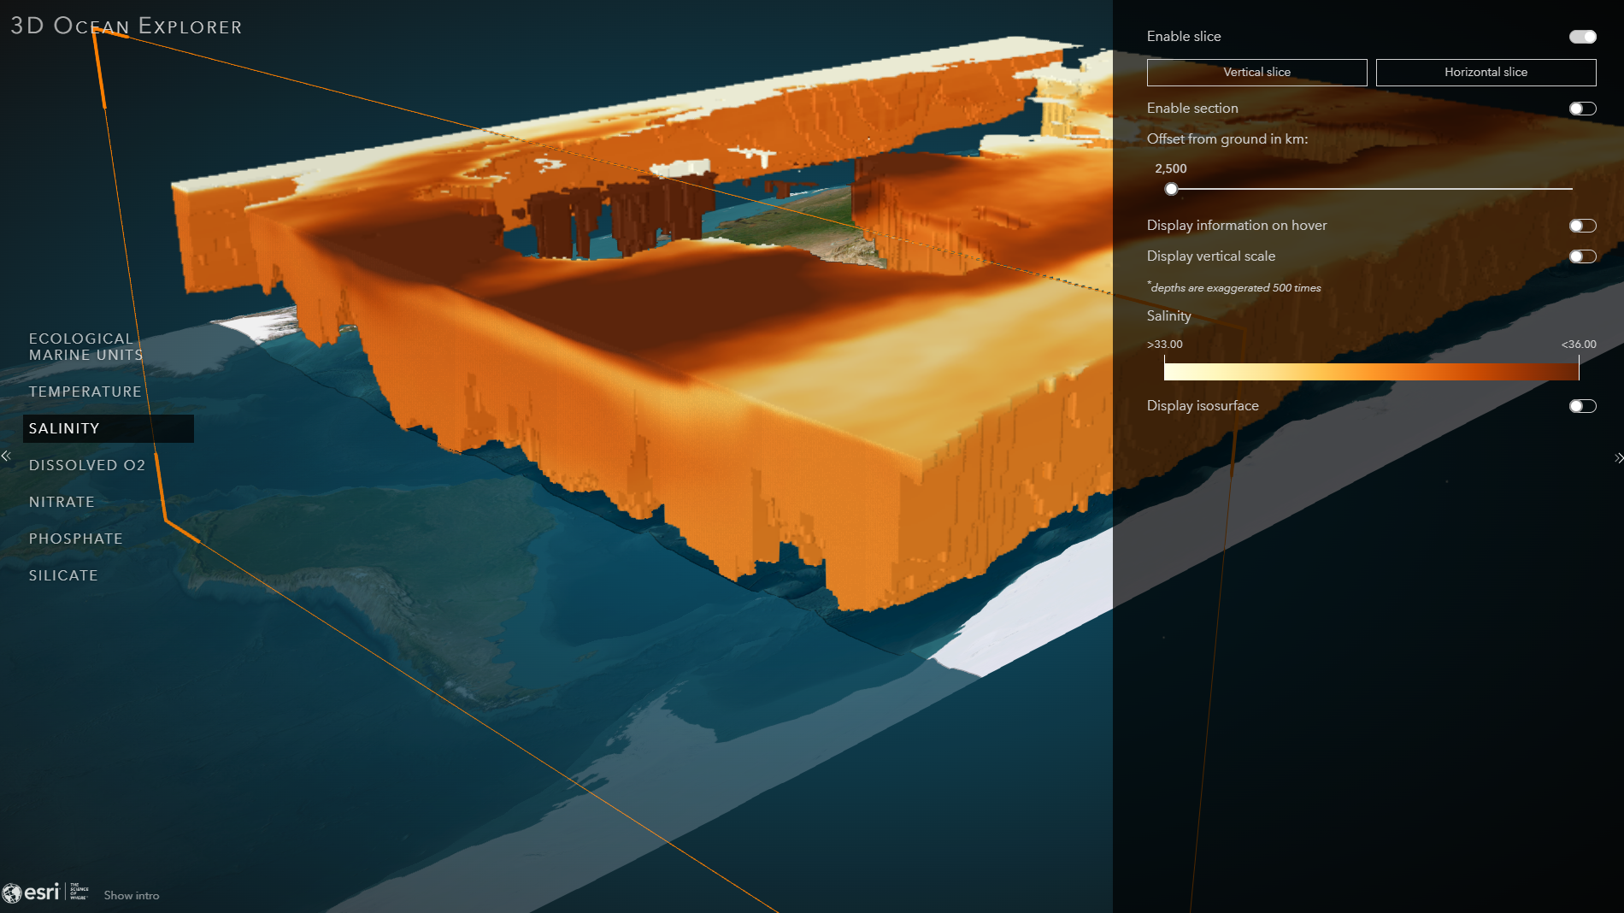
Scientific data
https://geoxc-apps4.bd.esri.com/geology-darmstadt/
https://geoxc-apps4.bd.esri.com/ocean-explorer/

Slide 24
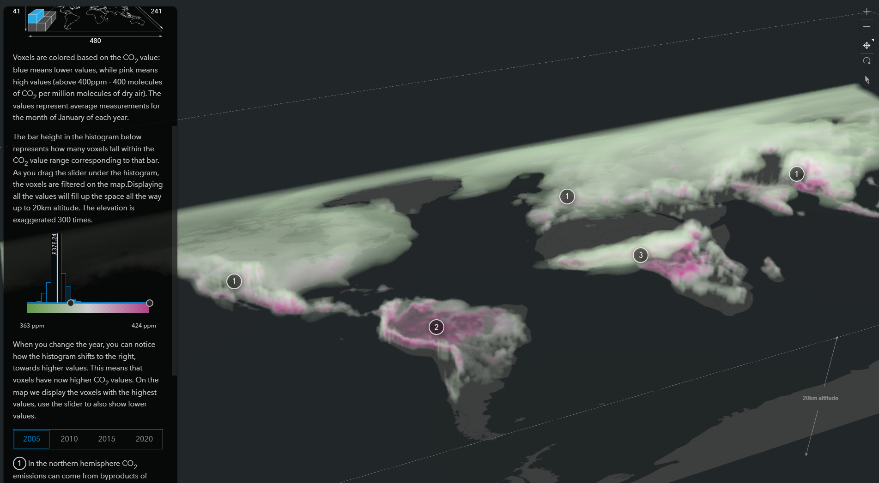
Scientific data – part II
https://ralucanicola.github.io/JSAPI_demos/carbon-dioxide/

Slide 25
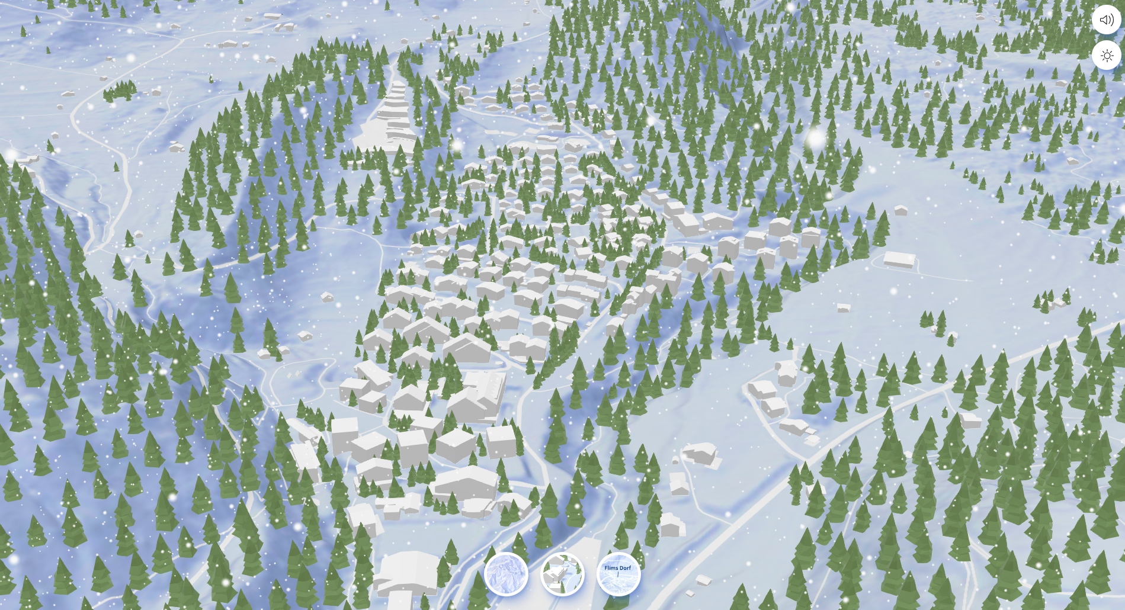
Maps and music
https://www.youtube.com/watch?v=cWZrt8OAxRw
https://ralucanicola.github.io/JSAPI_demos/winter-landscape/

Slide 26
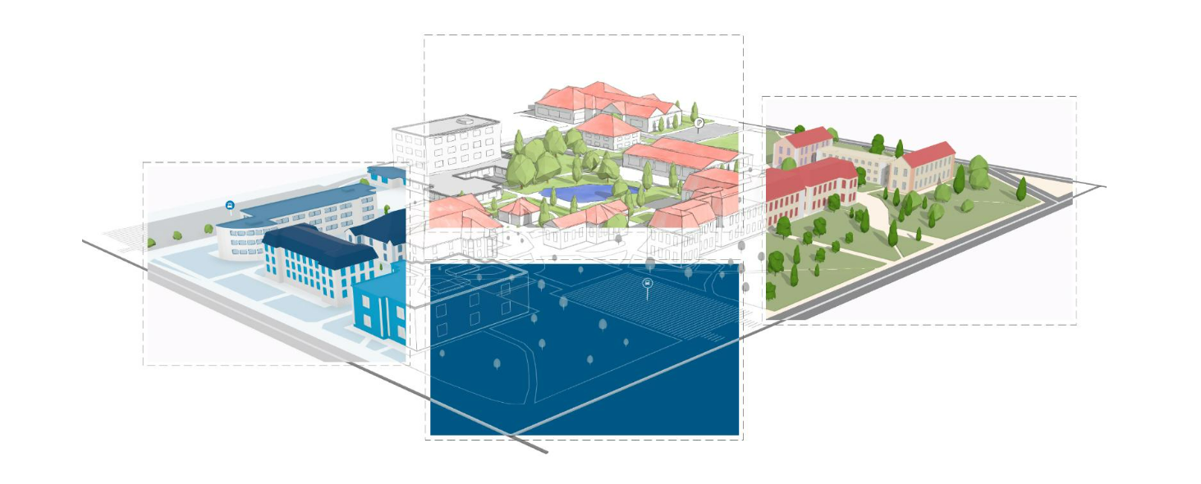
Map styles
https://storymaps.arcgis.com/stories/8692e3a5c1c049ae8727e4a218eac928

Slide 27
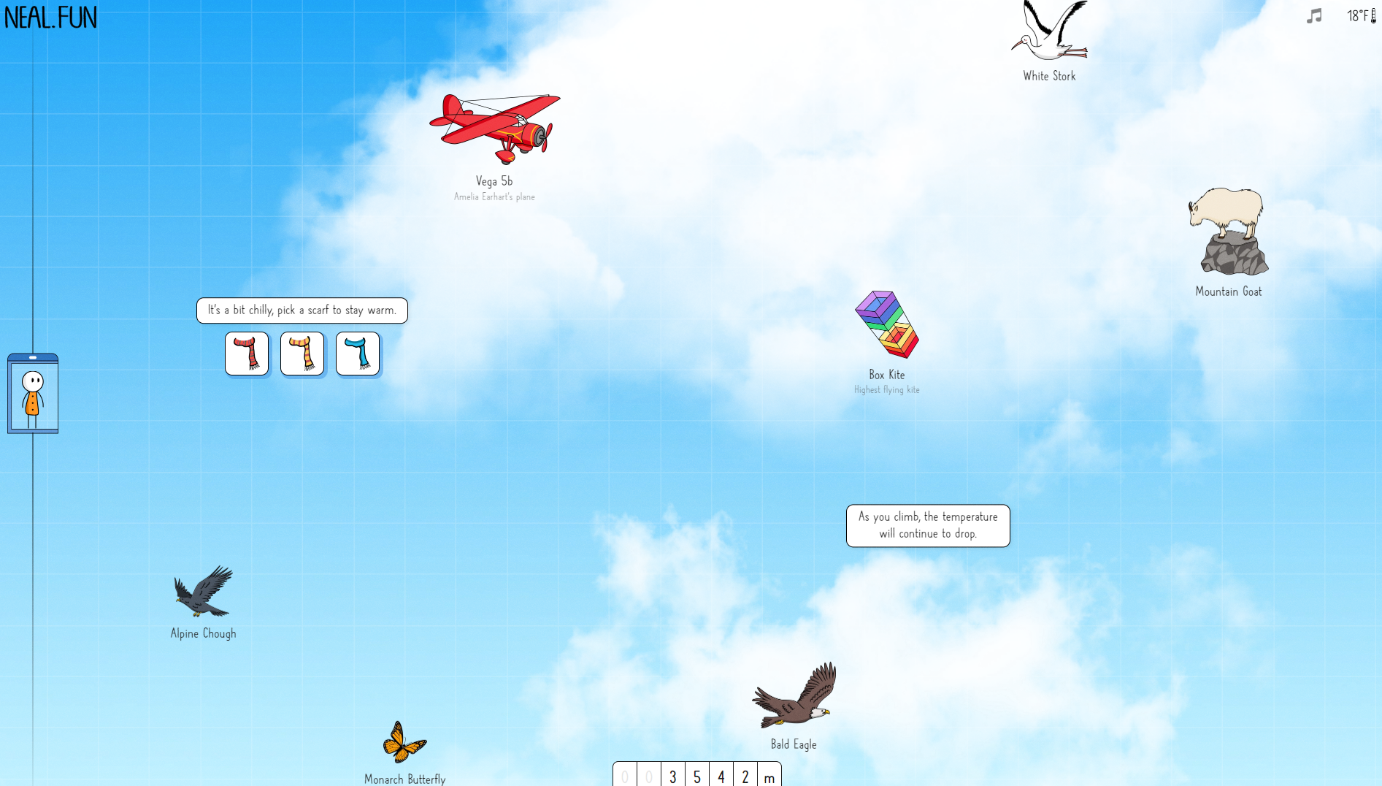
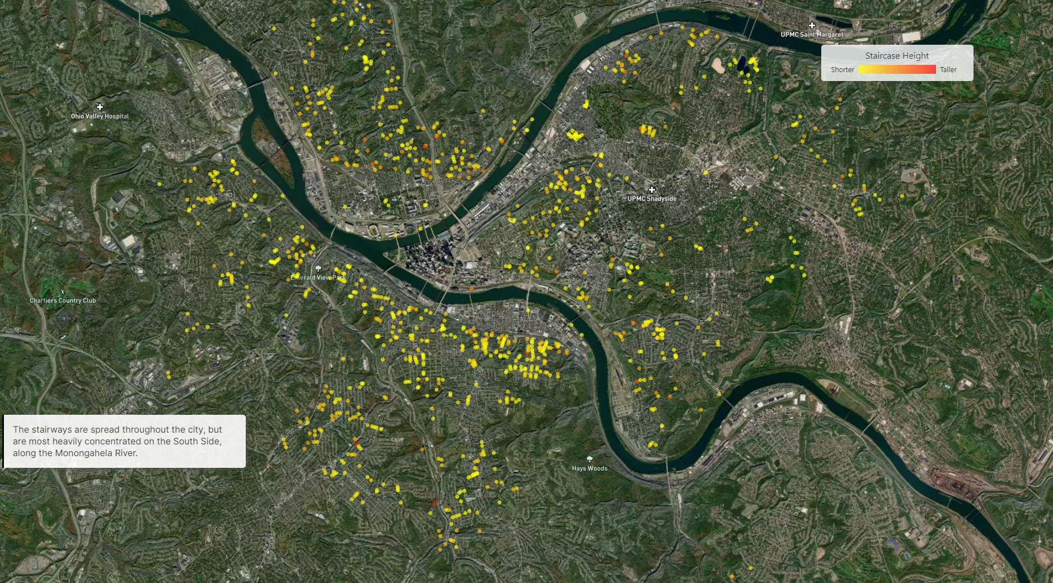
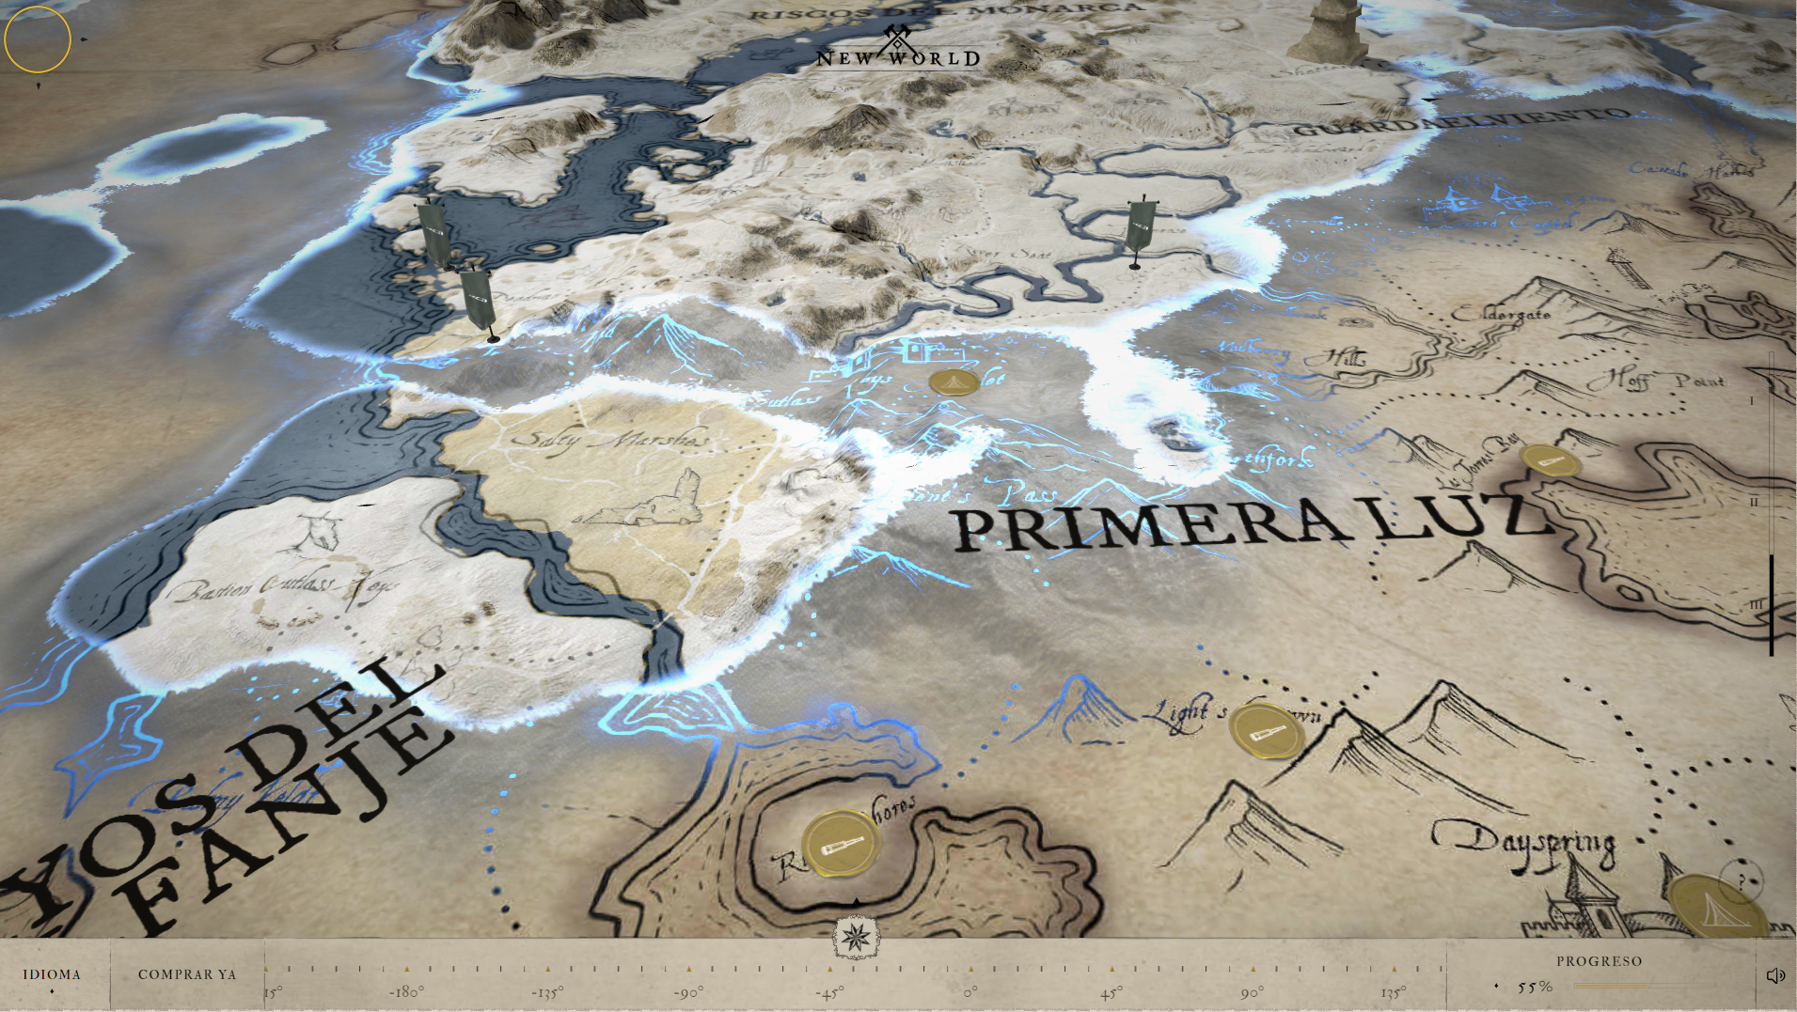
Some more inspiration
https://neal.fun/space-elevator/
https://pittsburgh-steps.samlearner.com/
https://www.informationisbeautifulawards.com/showcase
https://newworld-preview-0521.dev.60fps.fr/

Slide 28
Digital brain
Idea - keep a blog of your project and what you’re learning
Examples:
https://fabacademy.org/2021/labs/waag/students/nadieh-bremer/blog/
https://www.rauljimenez.info/docs/digital-brain
https://maggieappleton.com/basb (building a second brain)

Slide 29

Link to this presentation
https://github.com/RalucaNicola/hslu-presentations/tree/hslu-2023

